Slide 1




Tracking Political Trends Around US Presidential Election Through Social Media Analysis
Presented By:
Titans
(@kritika_garg, @KumushiniT, @HimarshaJ)
Computer Science Department,
Old Dominion University, Norfolk VA, USA
@WebSciDL, @NirdsLab
CSGS Hackathon, Fall 2024, October 24 – 31, 2024
Notes:
Hello everyone, good afternoon. I am Himarsha Jayanetti, here with Kumushini Thennakoon and Kritika Garg, We are group Titans. For the CSGS Fall 2024 hackathon we selected the topic on tracking political trends around social media.

Slide 2
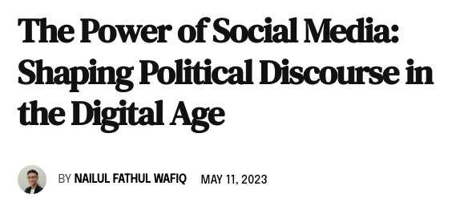
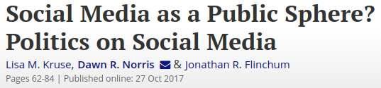
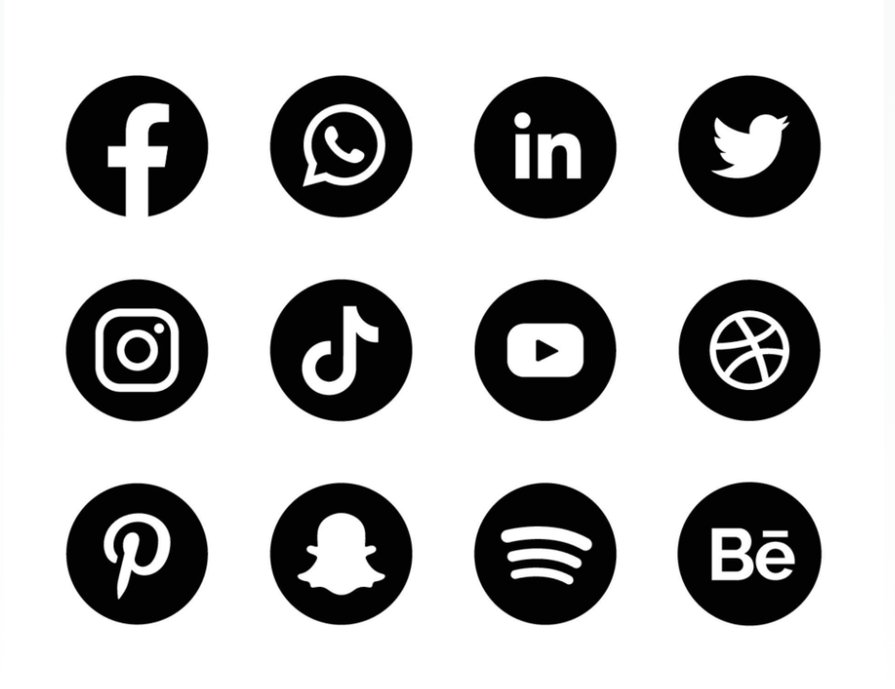
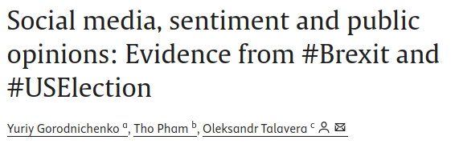
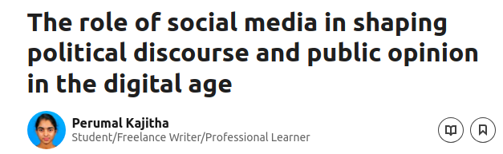
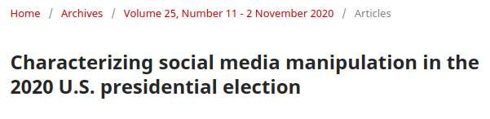
Social Media in Shaping Public Opinion and Political Discourse
https://doi.org/10.1080/00380253.2017.1383143
https://moderndiplomacy.eu/2023/05/11/the-power-of-social-media-shaping-political-discourse-in-the-digital-age/
https://doi.org/10.1016/j.euroecorev.2021.103772
https://www.linkedin.com/pulse/role-social-media-shaping-political-discourse-public-opinion-kajitha/
https://doi.org/10.5210/fm.v25i11.11431
Notes:
Social media has become a powerful platform for both the public to express opinions and for candidates to connect with voters. Studies show that trends on platforms like Twitter not only reflect public sentiment but can also shape political conversations in real time.

Slide 3
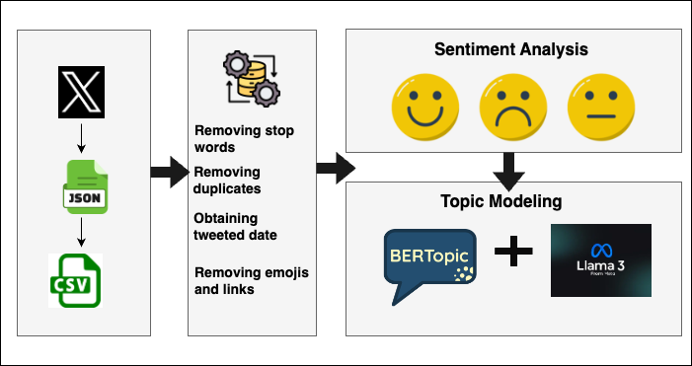
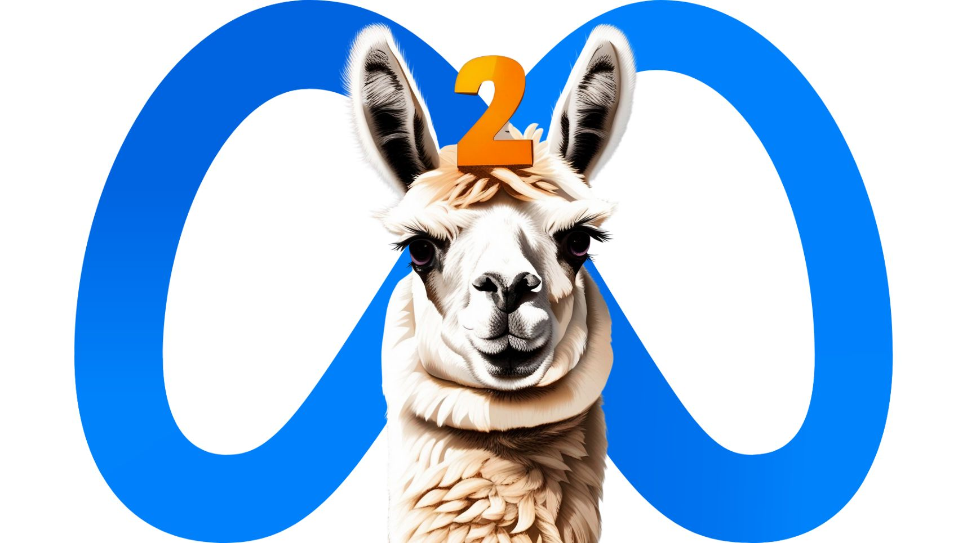
Approach and Tools for Conducting Social Media Analysis
https://pypi.org/project/selenium-wire/
https://maartengr.github.io/BERTopic/index.html https://github.com/cjhutto/vaderSentiment
Notes:
This is a quick overview of our methodology, we will go into details as we go. We got the data from Twitter (3100) and after the pre-processing of data (we got 2,750 tweet), we conducted sentiment analysis using VAder and topic modeling using BERTopic and LLama3.

Slide 4
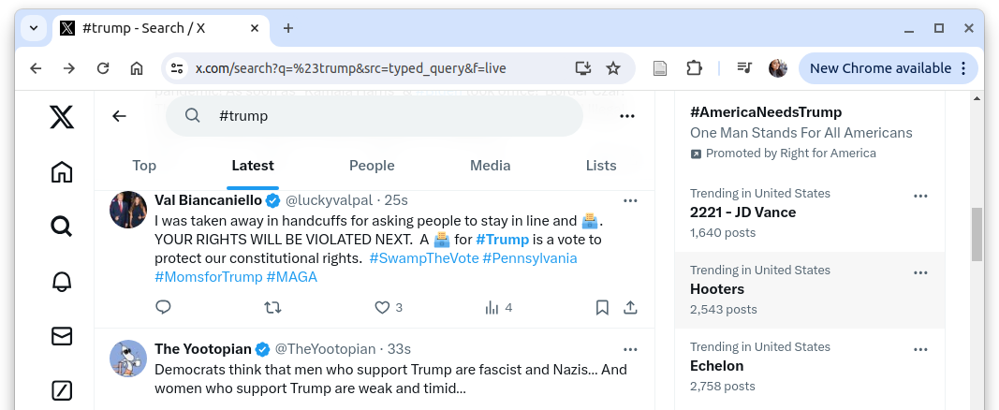

Extracting the Tweet ID, Username, Text, and Engagement
{
"content": { ...
"itemContent": { ...
"tweet_results": {
"result": {
"__typename": "Tweet",
"rest_id": "1852069852330234076",
"core": {
"user_results": {
"result": {
"__typename": "User", ....
"legacy": { ...
"screen_name": "luckyvalpal" ... },
"legacy": { ...
"favorite_count": 3,
"favorited": false,
"full_text": "I was taken away in handcuffs for
asking people to stay in line and \uD83D\uDDF3️.
YOUR RIGHTS WILL BE VIOLATED NEXT. A
\uD83D\uDDF3️ for #Trump is a vote to protect our
constitutional rights. #SwampTheVote #Pennsylvania
#MomsforTrump #MAGA",
"is_quote_status": false,
"lang": "en",
"quote_count": 0,
"reply_count": 0,
"retweet_count": 0 ... }
}
#donald | #presidentialelection
#trump | #pennsylvania
#kamala | #russia
#harris
https://ritetag.com/best-hashtags-for/election
Notes:
We used selenium-wire to capture the network traffic for the LATEST tab search query and filtered for the GRAPH QL URLs which contains the tweet details. We extracted the Tweet ID, Username, Text, and Engagement data.
( such as number Likes, RTs, QTs, and Replies for each tweet.)

Slide 5
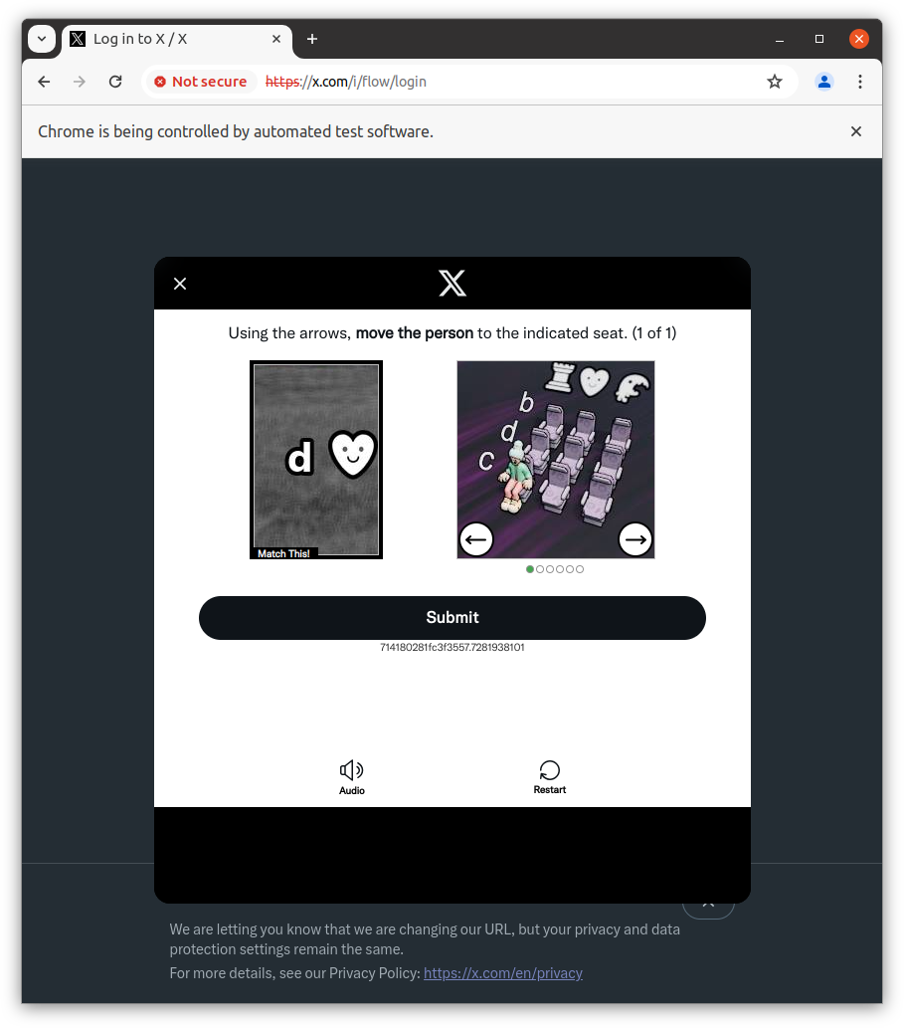
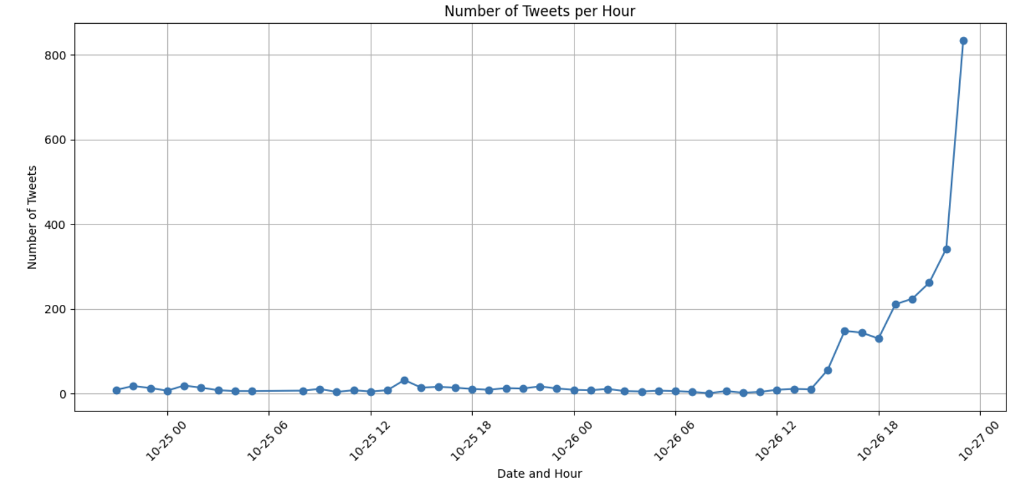
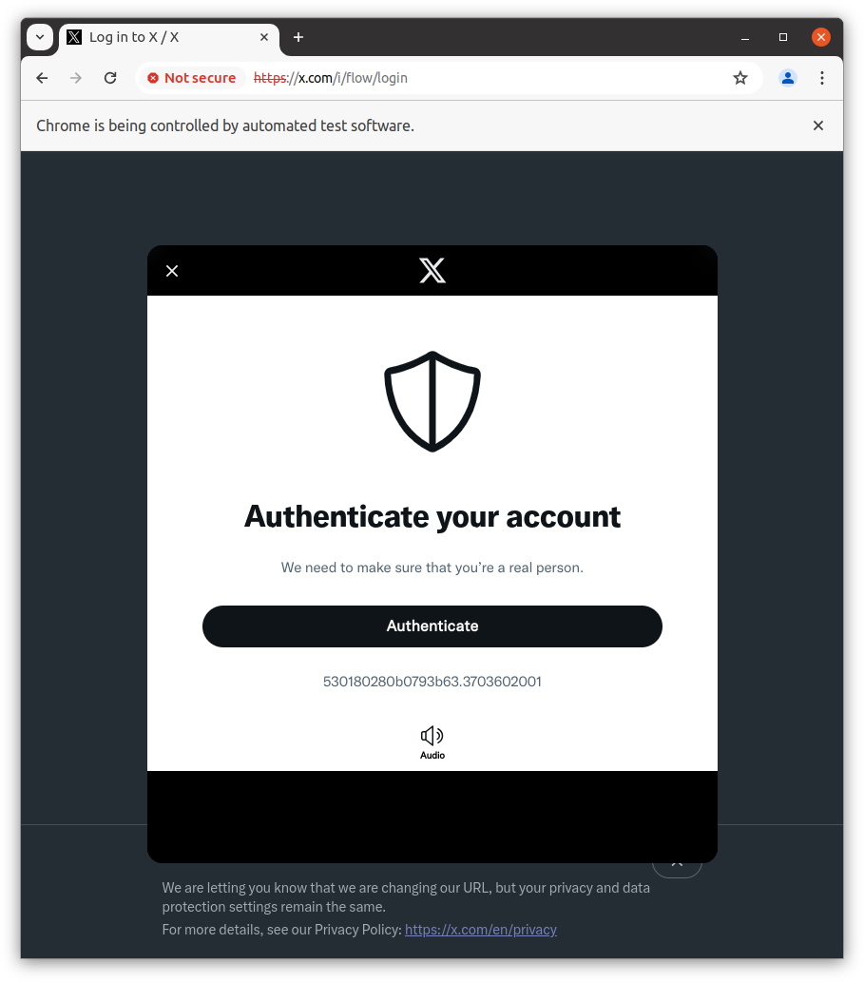
The Limited Dataset Reflects Challenges Encountered
During Web Scraping
Notes:
This chart shows the date and hour on the X-axis, with the number of tweets on the Y-axis. #Trump had lot of tweet,, but it drops off further back in time as we got rate limited. Our initial analysis showed this dataset doesn’t give the full picture, but with time constraints, we moved forward with what we had.

Slide 6
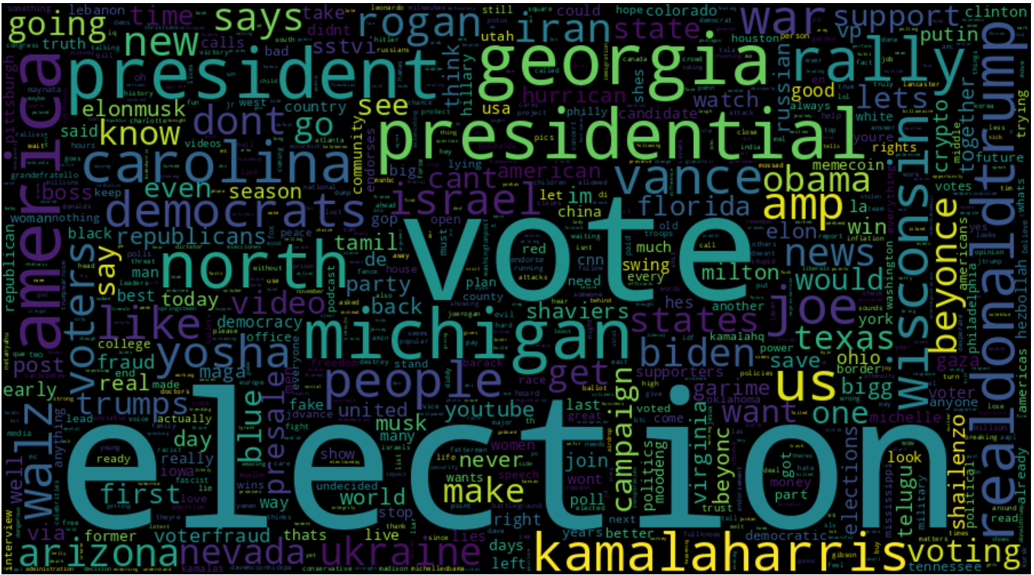
Trending Topics Among the Public
Notes:
To get a quick look at our data, This word cloud shows the trending topics among the public, excluding the hashtags we used for collection.

Slide 7
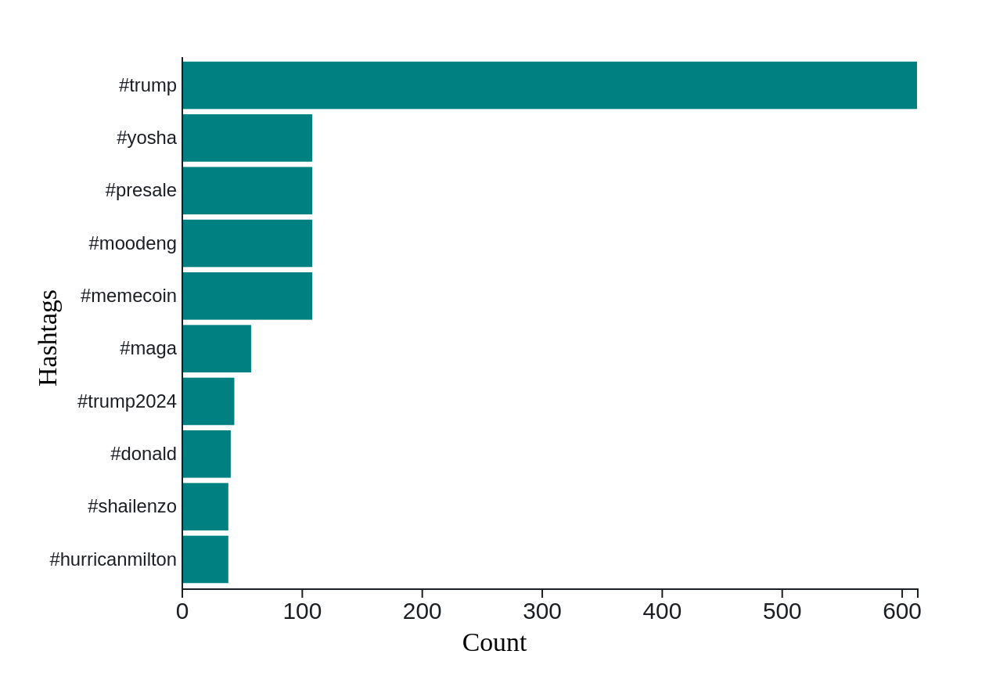
Counting Votes or Memecoins?
Hashtags with the #trump
The top most hashtags are #yosha, #presale, #moodeng, #memecoin, shows the nature of crypto discussions on social media.
#maga - “Make America Great Again”
#trump, #shailenzo, and #hurricanemilton are used for “hashtag hijacking”.
Notes:
We examined the top hashtags used with each of our hashtags, only discussing #Trump here, which include #yosha, #presale, #moodeng, and #memecoin, showing crypto discussions on social media. Additionally, #MAGA stands for 'Make America Great Again' and #trump2024 is present along with #donald.
We also noticed that #Trump, #shailenzo, and #hurricanemilton are examples of 'hashtag hijacking,' where popular tags are used to gain attention in unrelated conversations.

Slide 8
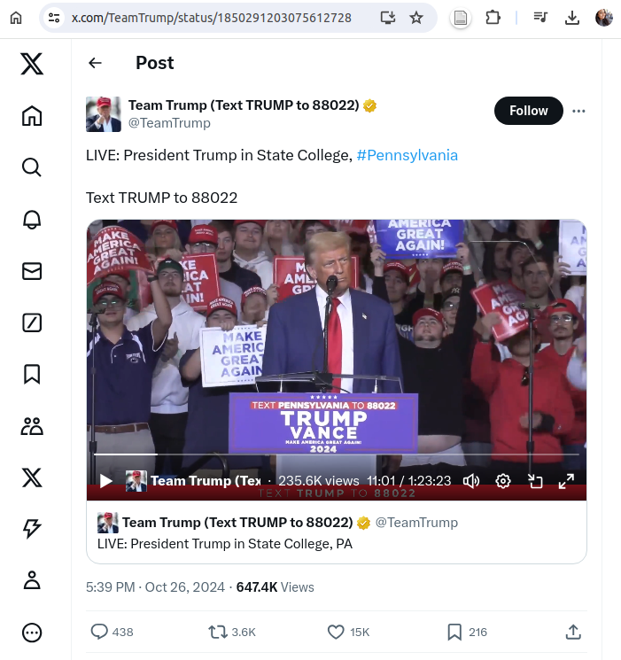
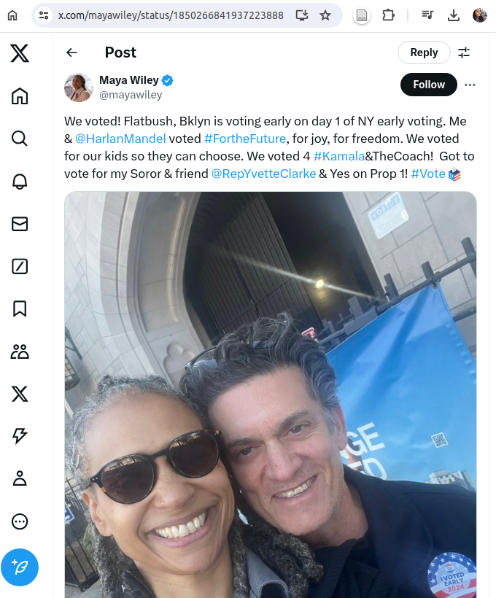
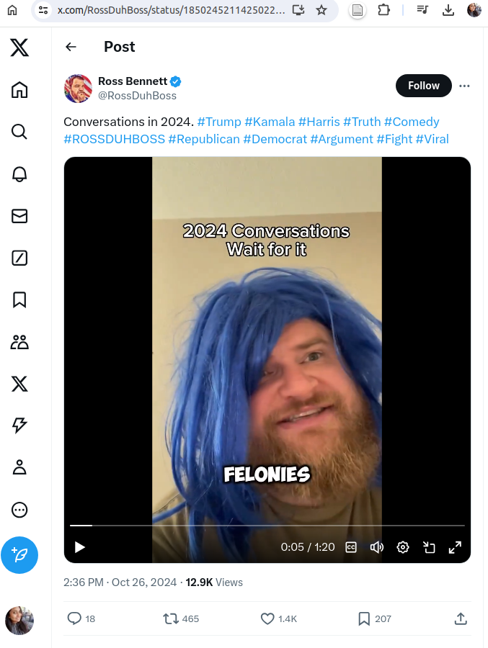
The Top 3 Most Liked Tweets
https://x.com/TeamTrump/status/1850291203075612728
Likes: 15,851
https://x.com/mayawiley/status/1850266841937223888 Likes: 4270
https://x.com/RossDuhBoss/status/1850245211425022373
Likes: 1433
Notes:
Here are examples from our engagement metrics: the top three tweets with the most likes—one from a Trump rally, one supporting Kamala, and one about 2024 election conversations—also showing a balance of perspectives.Now I will handover to kumushini to discuss - Sentiment analysis

Slide 9
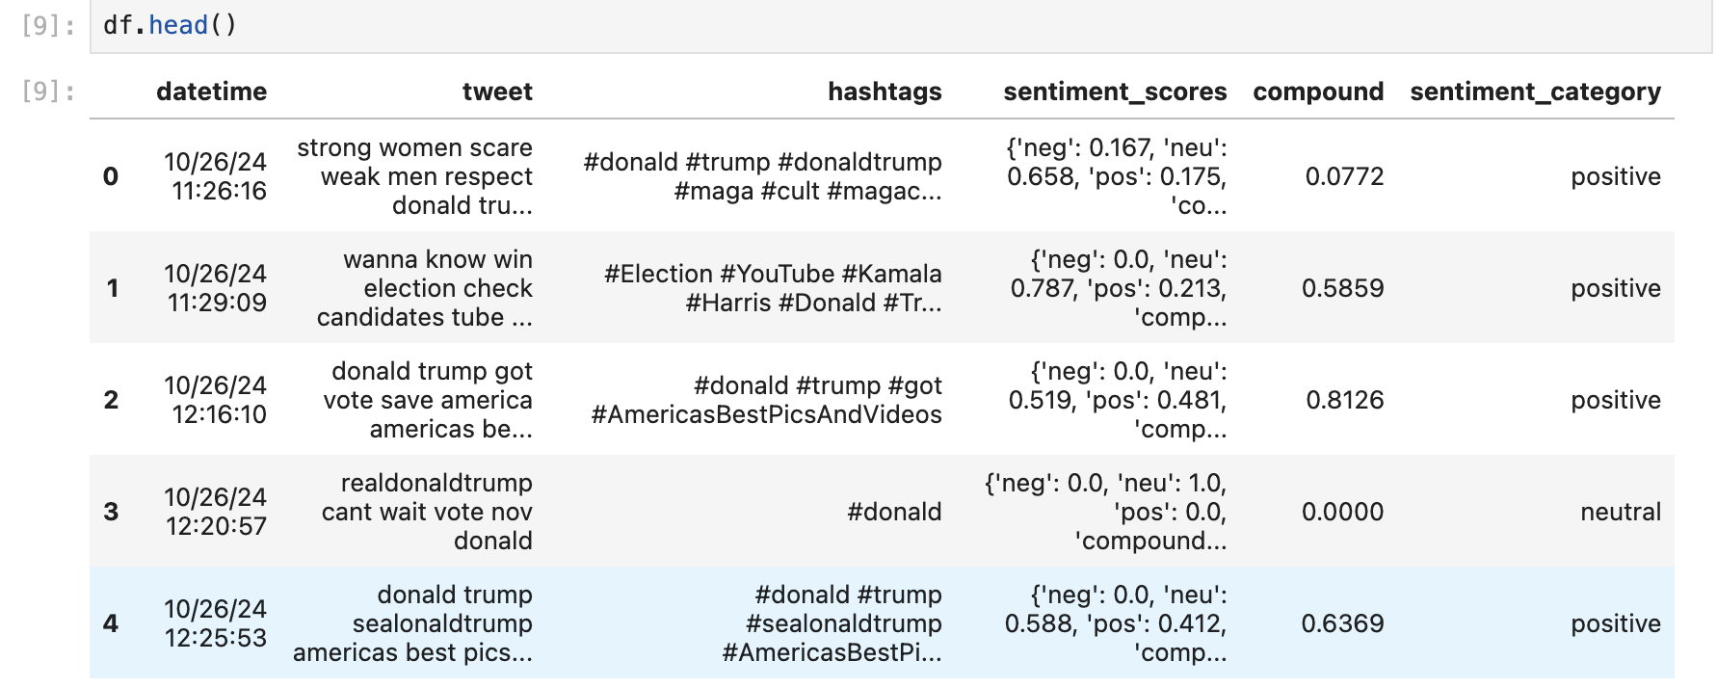
Analyzing Sentiments of Tweets with Vader

Slide 10
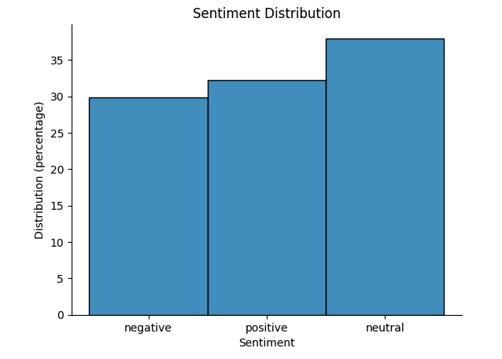
A Balance of Perspectives in Election Discussion

Slide 11
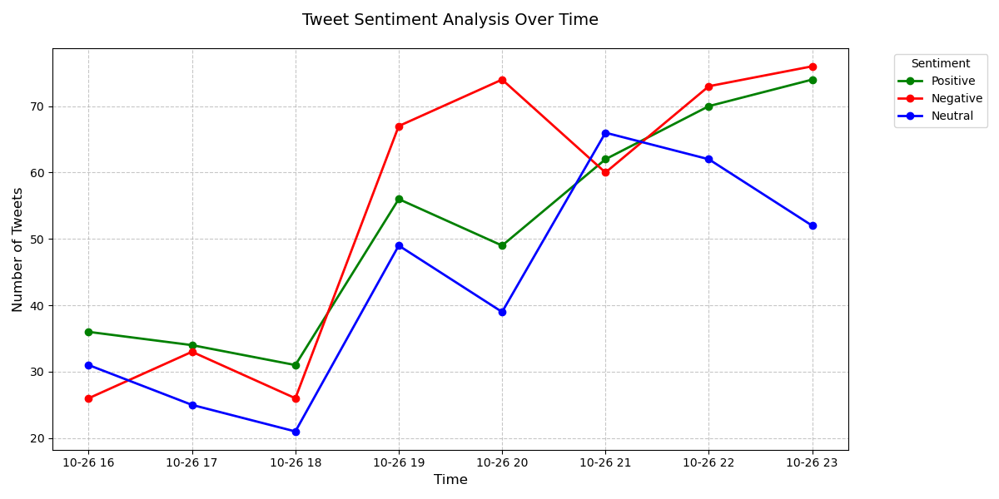
Sentiment Analysis of Tweets Mentioning Kamala Harris

Slide 12
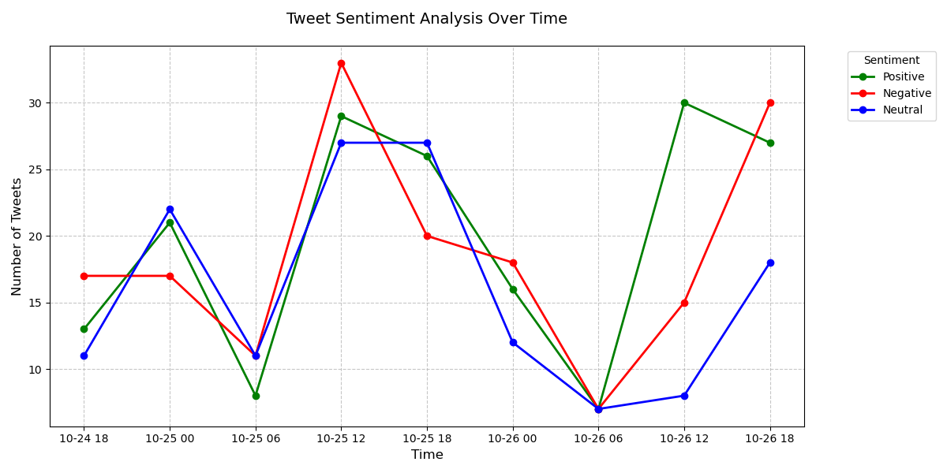
Sentiment Analysis of Tweets Mentioning Presidential Election

Slide 13
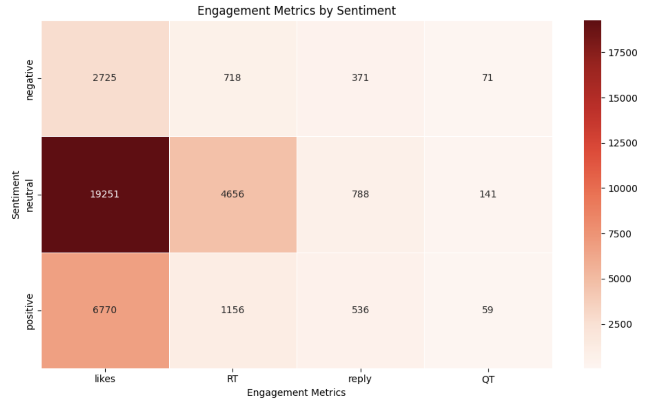
Tweets With Neutral Sentiment Achieved the Highest Levels of Engagement
Notes:
distribution of engagement metrics (likes, retweets, replies, and quotes) across three sentiment categories: positive, neutral, and negative.

Slide 14
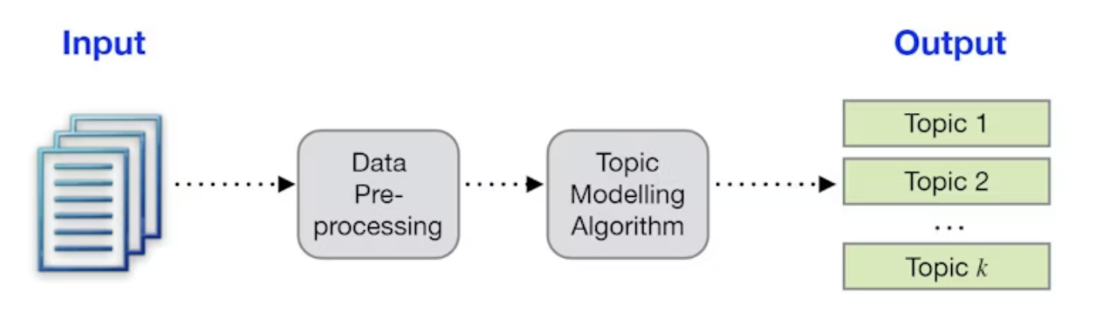
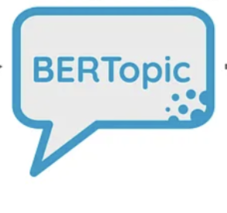
Topic Modelling To Identify Trending Election Topics Among Public
Tweets
https://hackernoon.com/nlp-tutorial-topic-modeling-in-python-with-bertopic-372w35l9

Slide 15
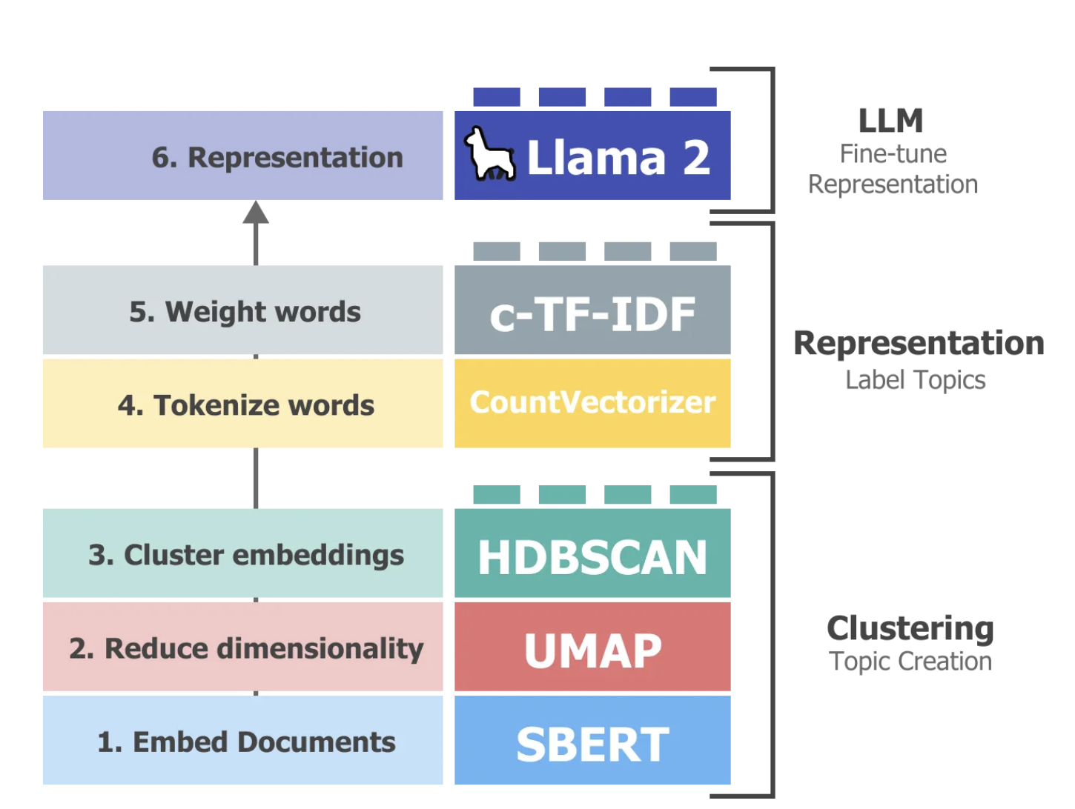
Fine-tune the topic representations generated by BERTopic
https://newsletter.maartengrootendorst.com/p/topic-modeling-with-llama-2

Slide 16
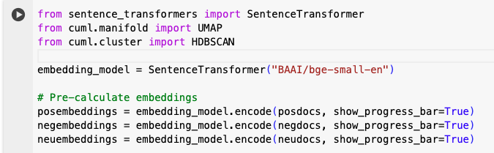
Transforming Tweets into Numerical Representations with Sentence Transformers

Slide 17
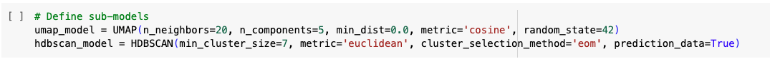
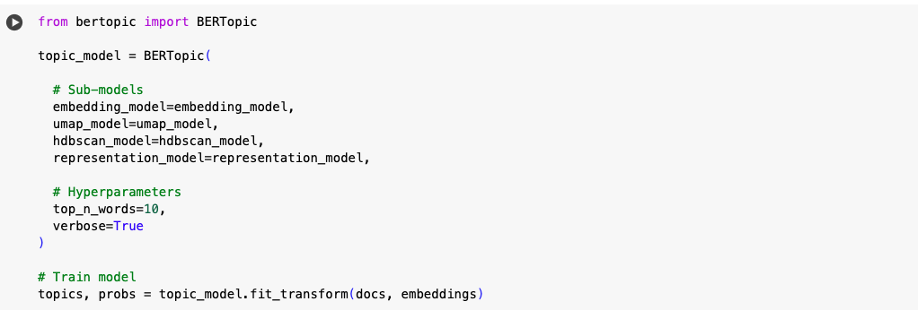
Training the BERTopic Model

Slide 18
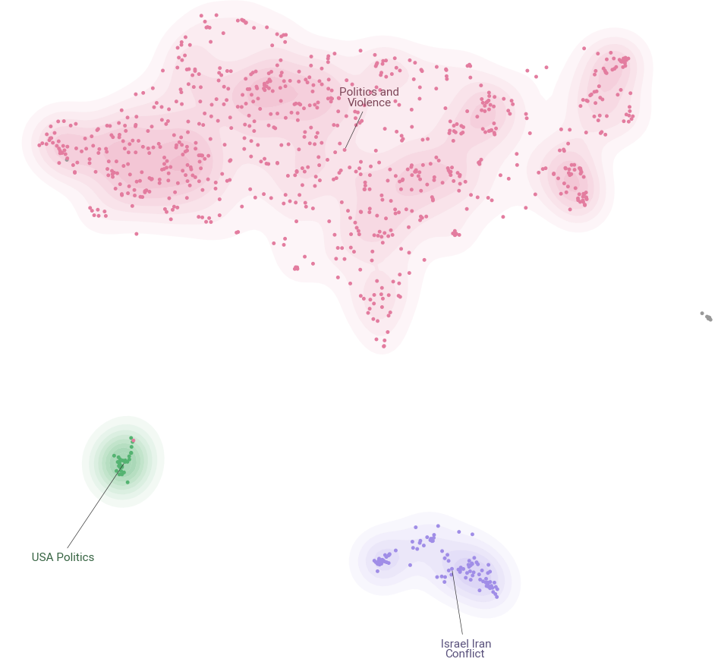
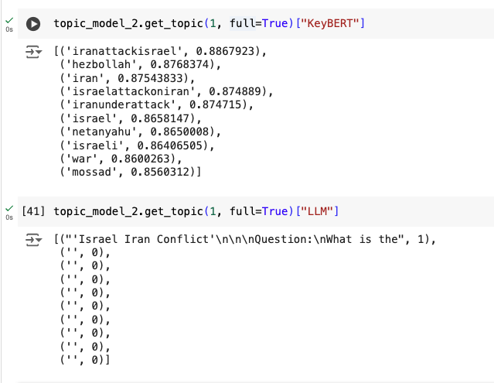
Topic Modeling on Negative Sentiments Tweets

Slide 19
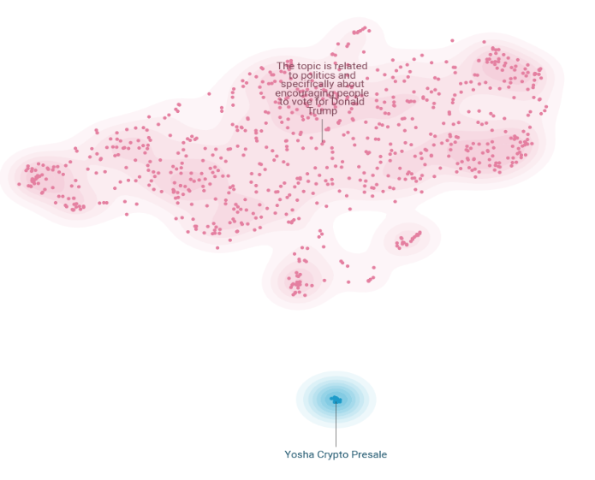
Topic Modeling on Positive Sentiments Tweets

Slide 20
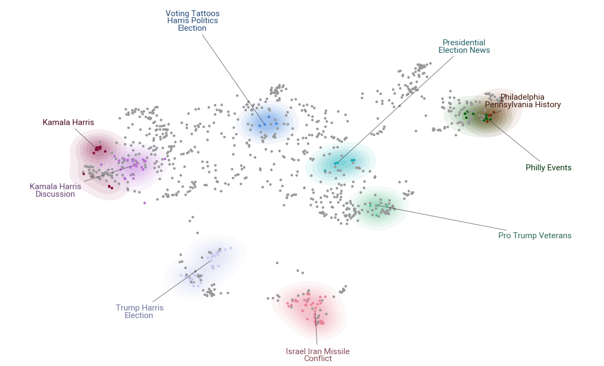
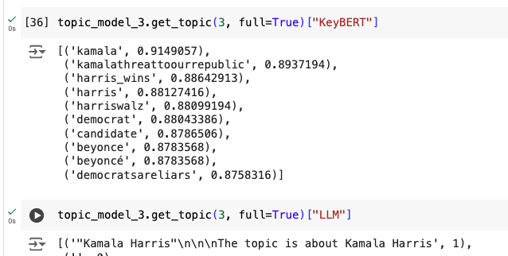
Topic Modeling on Neutral Sentiments Tweets

Slide 21
Conclusions
Studies have shown that social media plays a key role in shaping public opinion.
A balance of perspectives in election discussion
38% Neutral
32% Positive
30% Negative
Tweets with neutral sentiment achieved the highest levels of engagement.
The topics reflect the blend of local and international concerns.
The small size of our dataset limited the model's ability to capture a comprehensive range of topics when split into three subsets based on Sentiment.
Twitter's stringent rate limits pose significant challenges for web scraping!
Team Titans
https://github.com/kritikagarg/titansPoliTrend
Notes:
Social media plays a key role in shaping public opinion, with a balance of sentiment in election discussions. Neutral tweets received the most engagement, reflecting a blend of local and international concerns. Twitter's rate limits caused our dataset to be of small size limited the model's ability to fully capture these trends but we know that this framework would be highly effective with a richer text dataset from Twitter or another source.

